Slide 1

OTT Big Data Analysis

Slide 2
Agenda
Architecture
Data Overview
Analysis
Visualizations
Summary

Slide 3








Architecture
ETL
Analysis
BI
Source

Slide 4
Data Overview
Amazon Prime Video
Movie Name
Language
Imdb rating,
Maturity rating,
Netflix
Country wise Movies & Series watched
Ratings, genre & duration
Title, cast & Description
Disney
Movie wise awards, votes and ratings
Director, writer and actors
release year, language and country

Slide 5

Analysis
14 Questions
Apache Hive
Spark SQL
PySpark

Slide 6
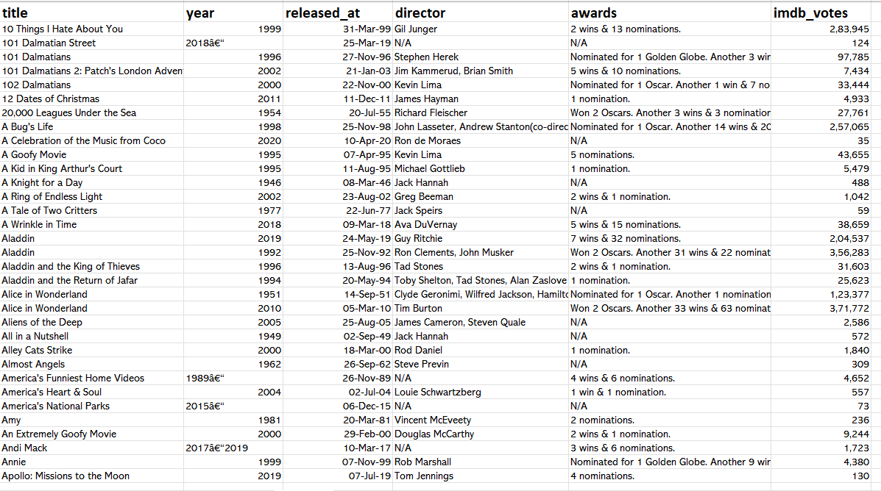
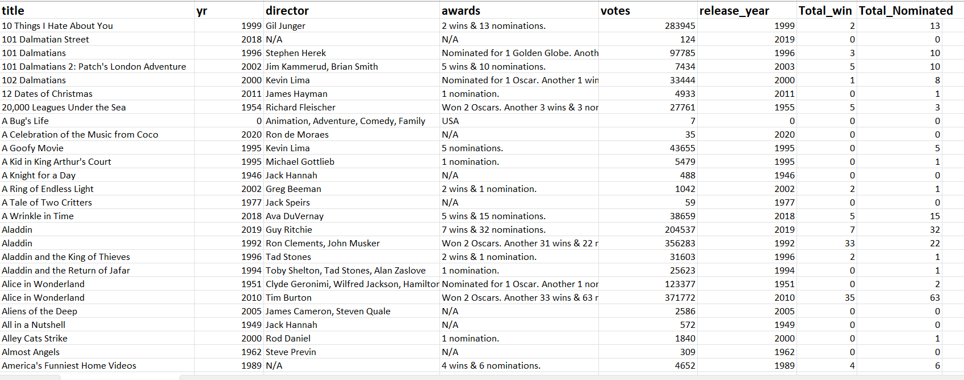
Disney Hotstar Data
Before Processing
After Processing

Slide 7
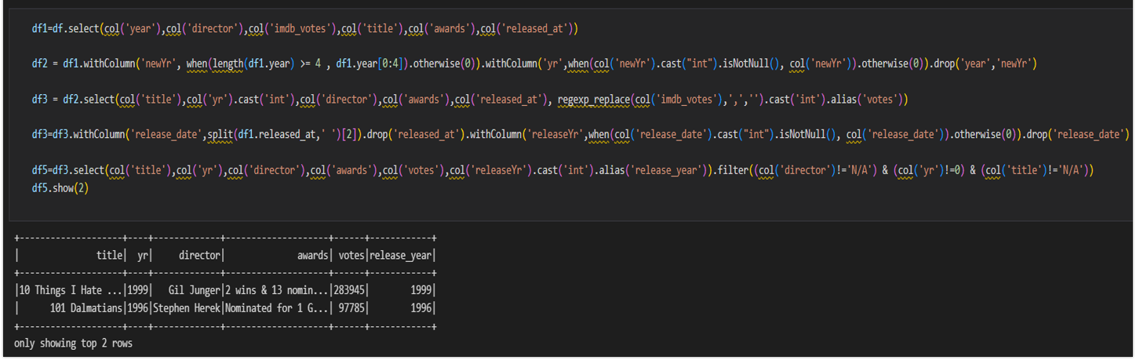
Pre-Processing Disney Hotstar Dataset

Slide 8
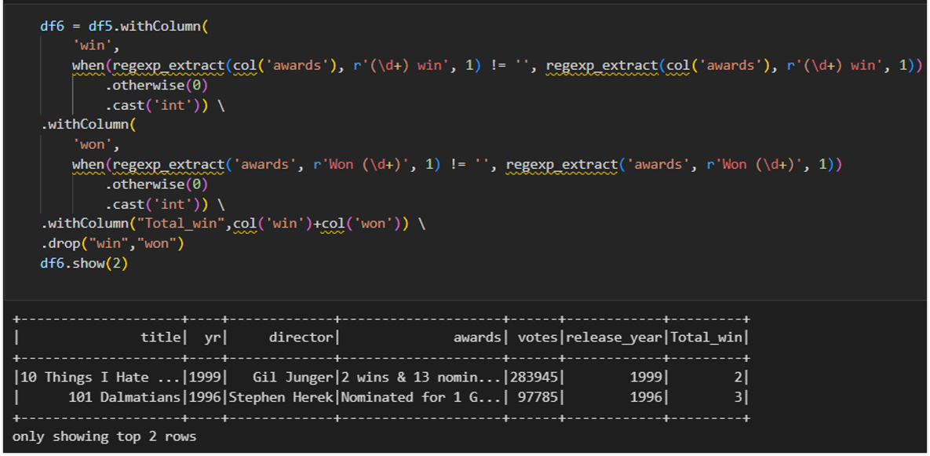
Extracting Wins Disney Hotstar Dataset

Slide 9
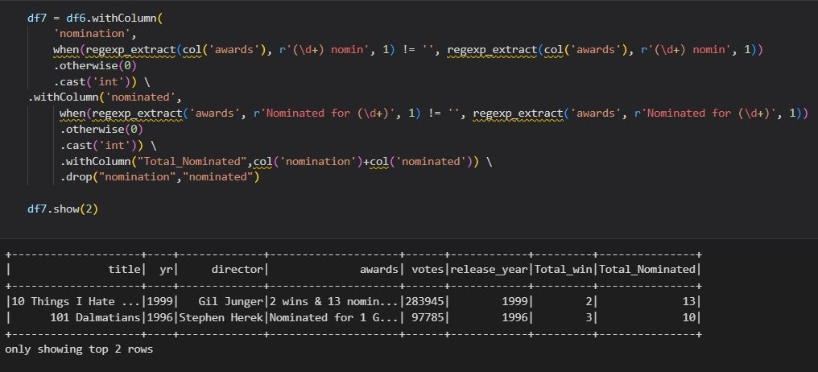
Extracting Nominations Disney Hotstar Dataset

Slide 10
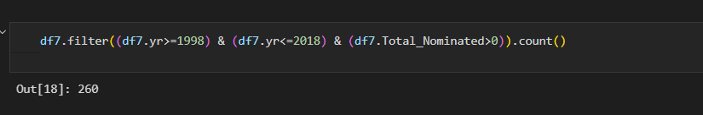
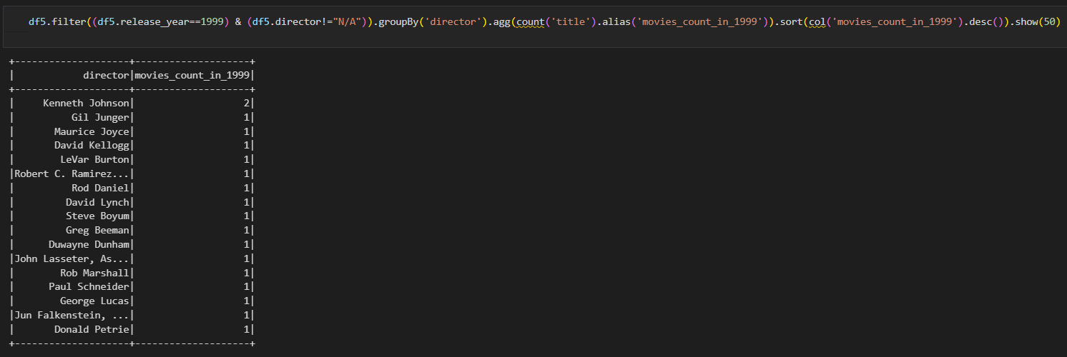
Disney Hotstar Data Frames API
Total Number of movies nominated for awards between 1998-2018?
Total number of movies released in 1999, Director wise

Slide 11
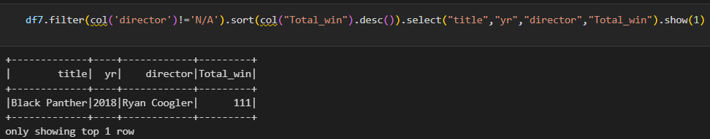
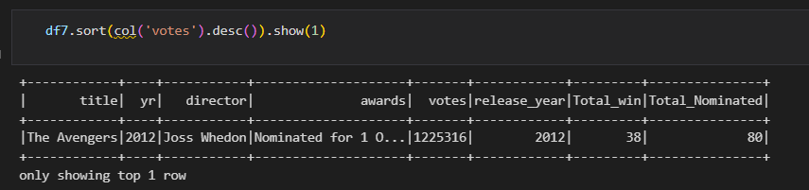
Disney Hotstar Data Frames API
Which year movies got highest awards? And which Director?
Which director’s movie has the highest votes? And which year?

Slide 12
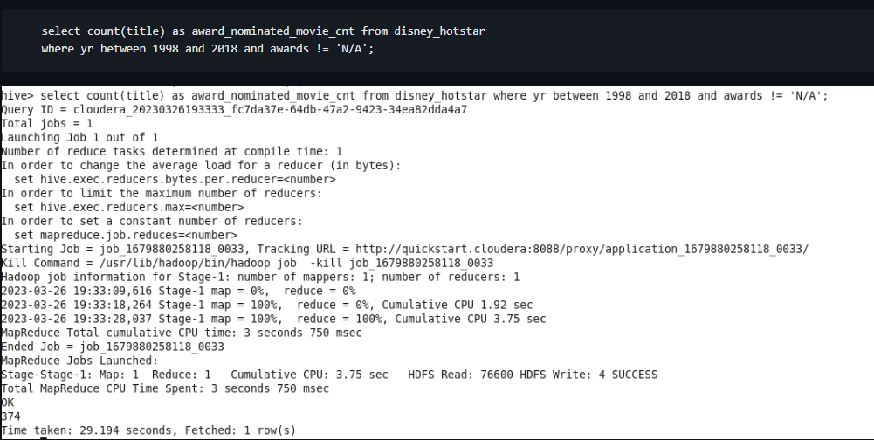
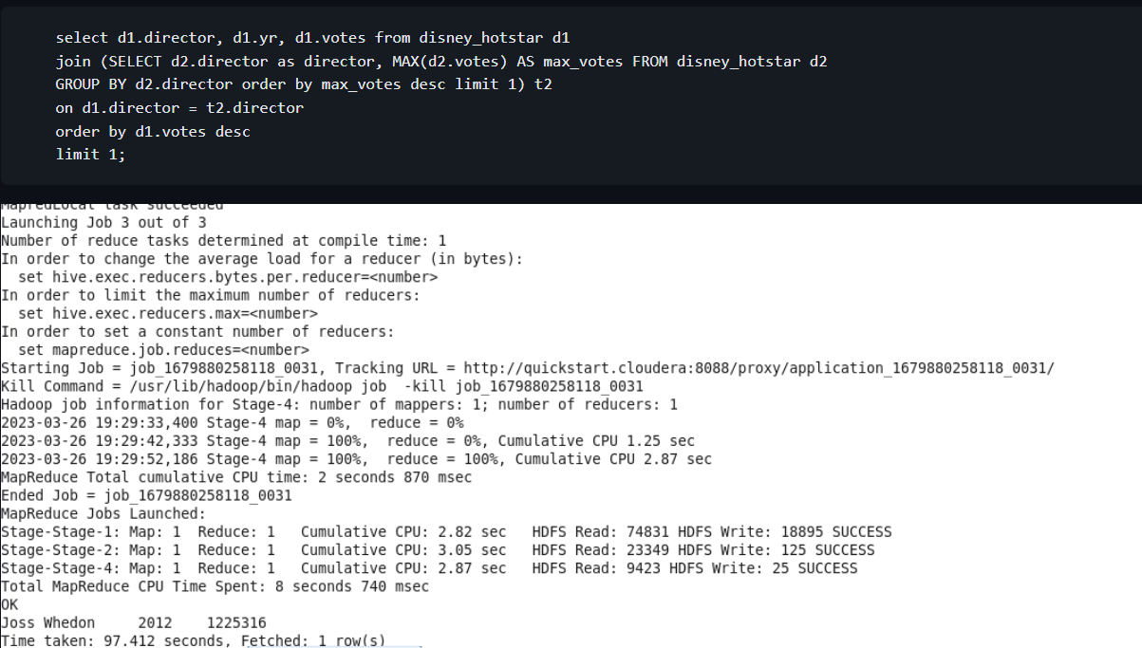
Disney Hotstar Hive
Total number of movies nominated for awards between 1998-2018?
Which director’s movie has the highest votes? And for which year?

Slide 13
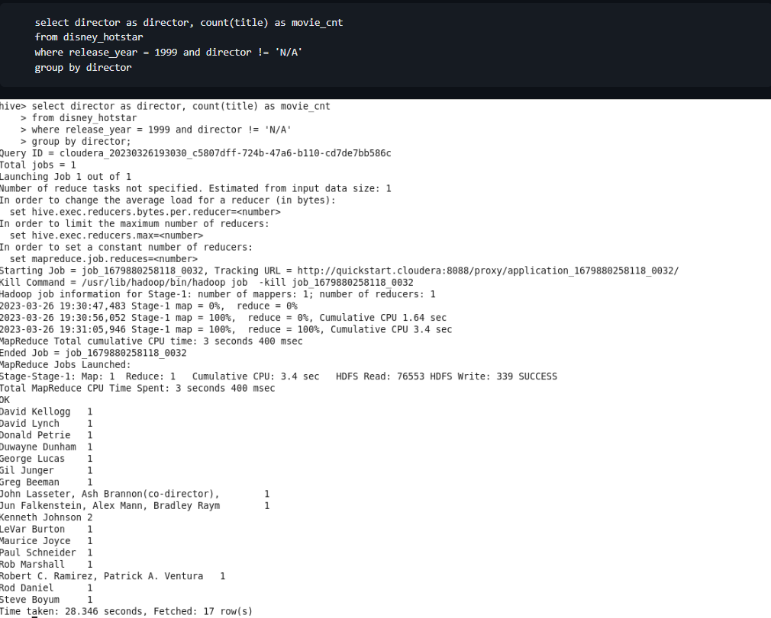
Disney Hotstar Hive
Total Number of movies released in 1999, director wise

Slide 14
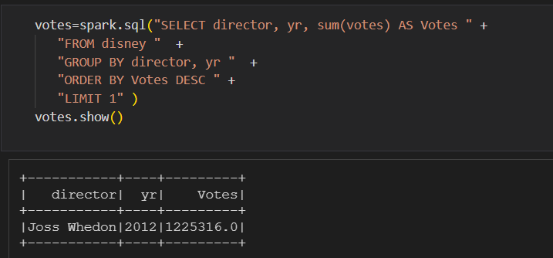
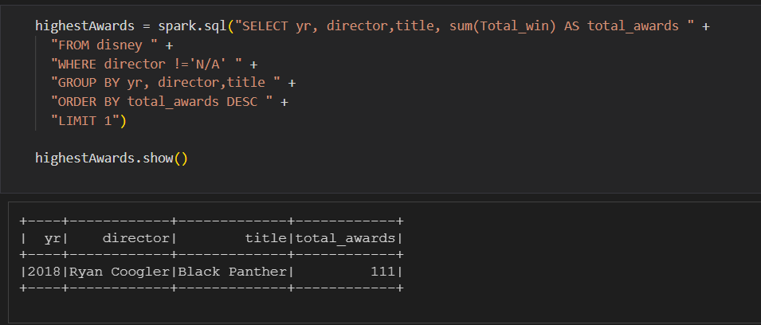
Disney + Hotstar Spark SQL
Which Director’s movies has the highest votes and for which year?
Which year movie got highest awards?

Slide 15
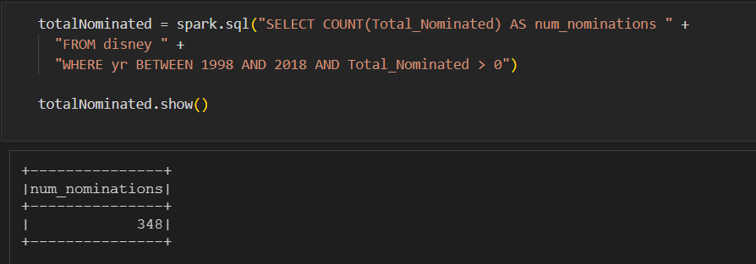
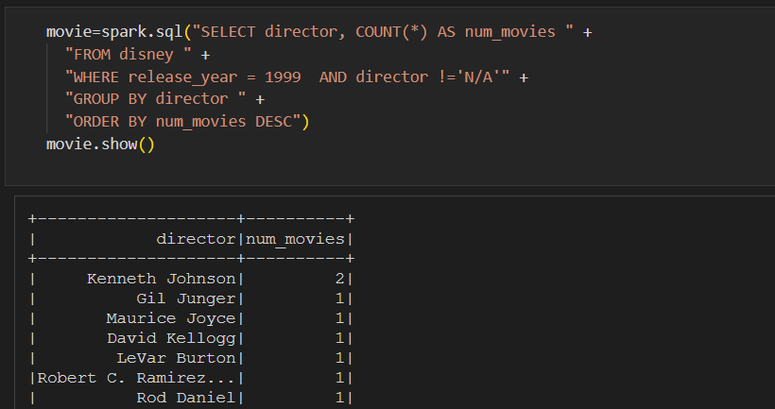
Disney + Hotstar Spark SQL
Total no of movies nominated for awards between 1998-2018
Total no of movies released in 1999, Director wise

Slide 16
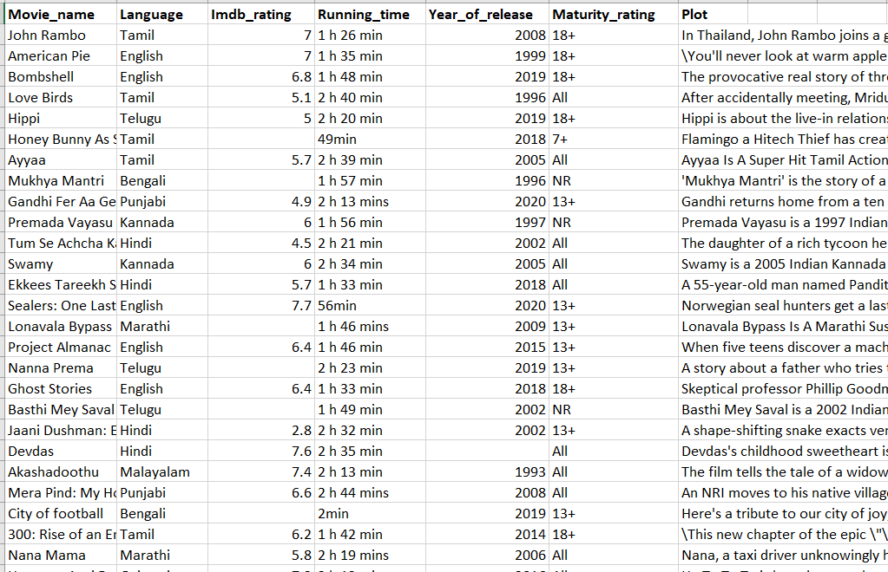
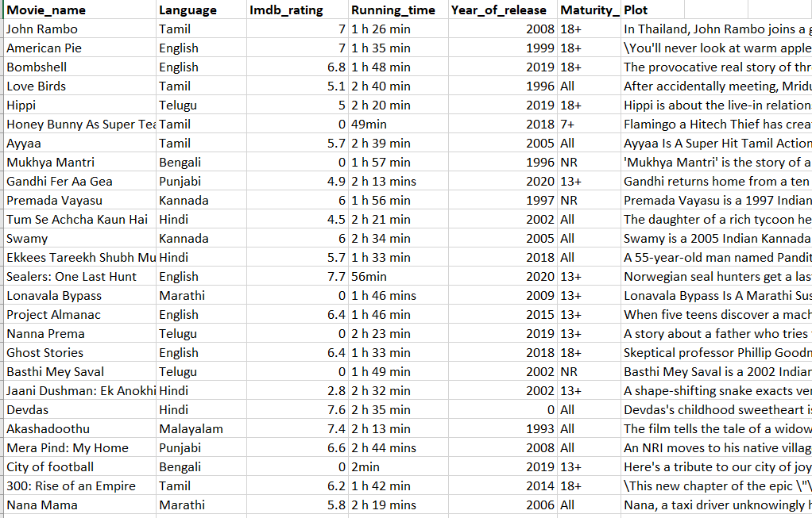
Amazon Prime Data
Raw Data
Processed

Slide 17
Hive Analysis
Why Hive?
External Table?
Partitioning & Bucketing
Optimization
Exporting

Slide 18
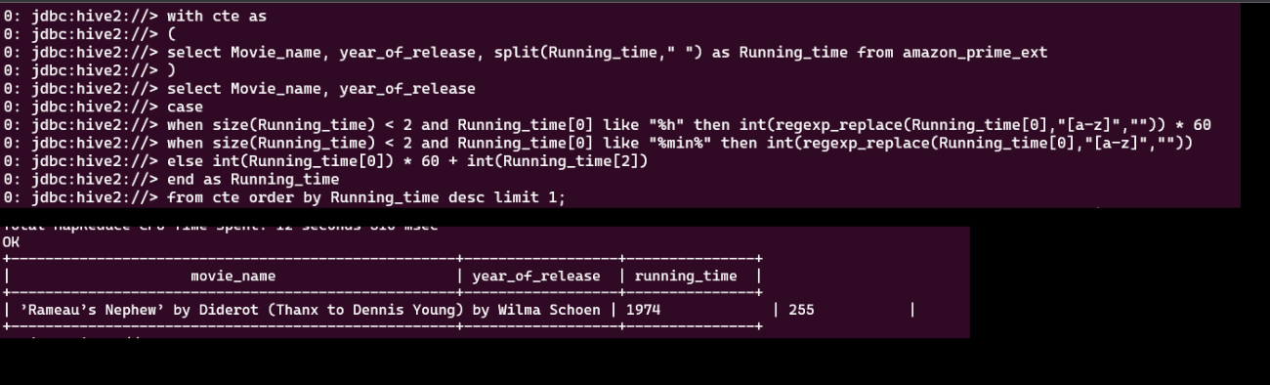
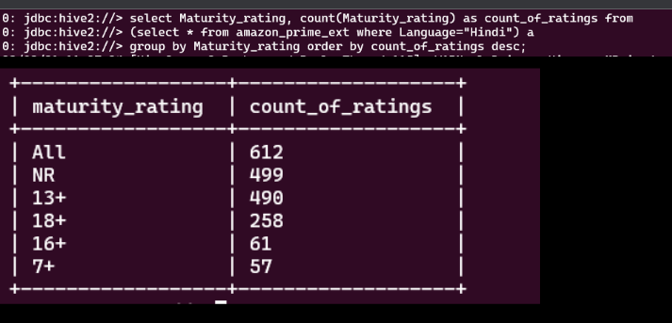
Amazon Prime Hive
Which movie has the highest running duration, In which year?
Which age group is watching Hindi Movies?

Slide 19
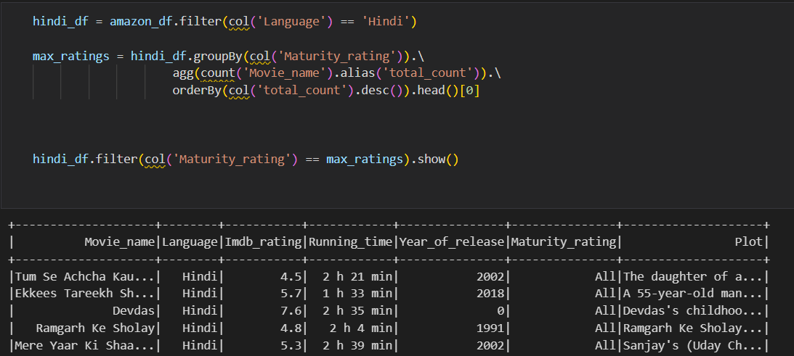
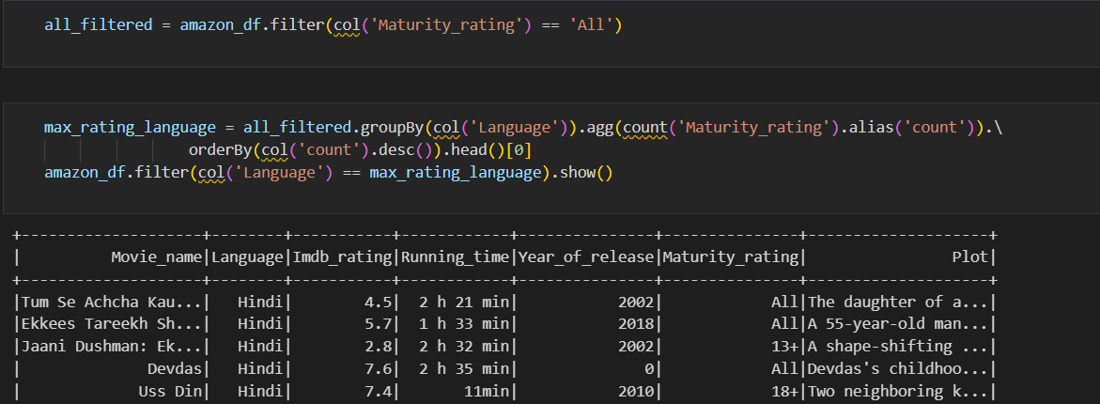
Amazon Prime Data Frames API
Which age Group is watching Hindi Movies, with movie titles
Which are the languages, movies highly watched by people of all ages?

Slide 20
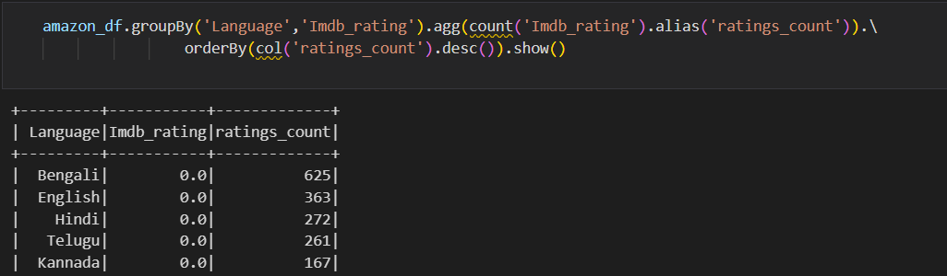
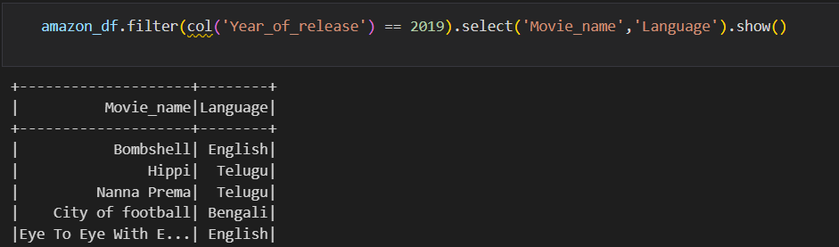
Amazon Prime Data Frames API
Review the total number of movie ratings by language wise, and what are the movies that are high maturity rating?
Review the movie names and languages names in the year of 2019

Slide 21
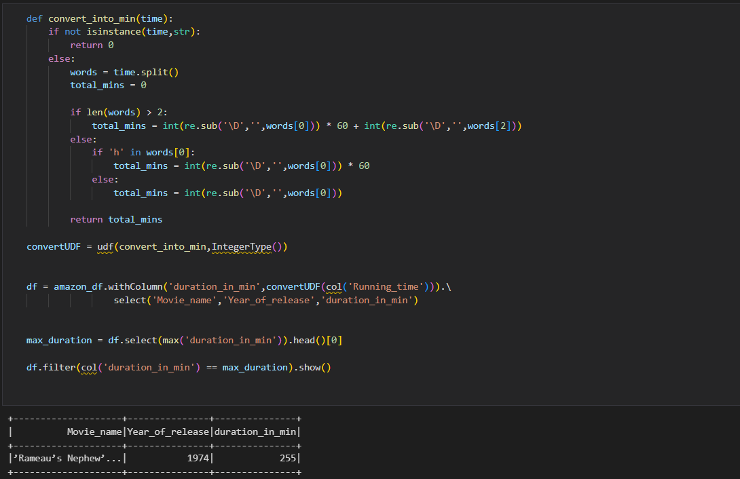
Amazon Prime Data Frames API
Which movie has the highest running duration and in which year?

Slide 22
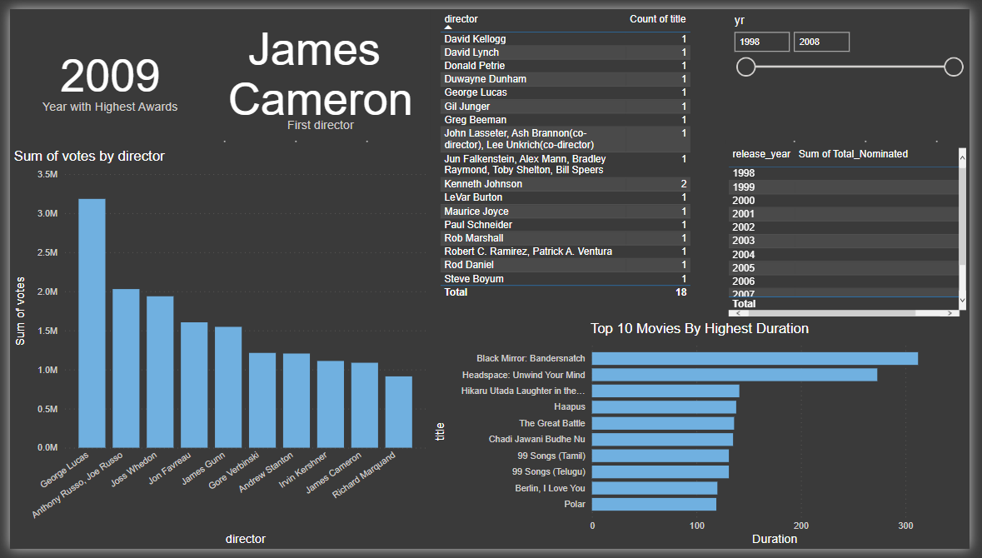
Power BI Dashboard

Slide 23
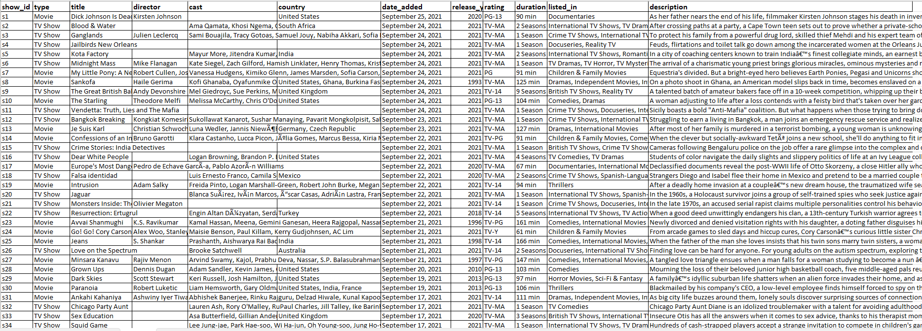
Netflix Data

Slide 24
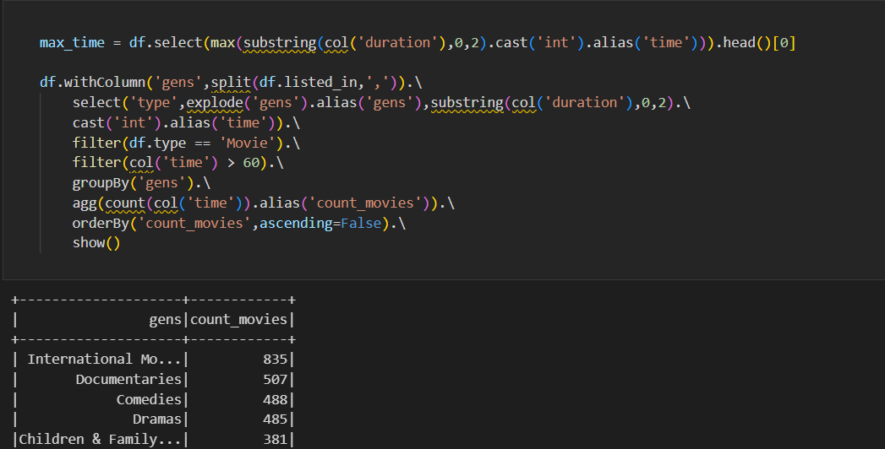
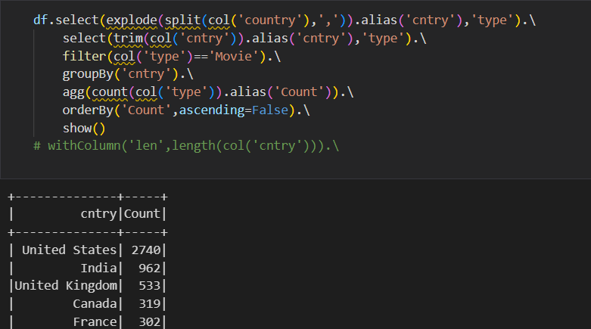
Netflix Data Frames API
What type of movies has highest duration (more than 1 Hr.)? total number of movies of that type
In which country highest movies were released?

Slide 25
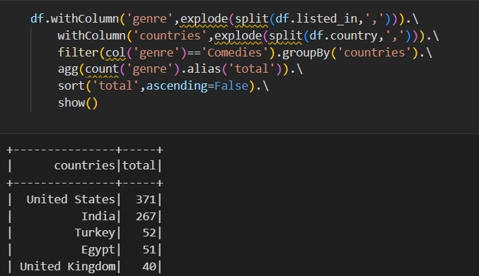
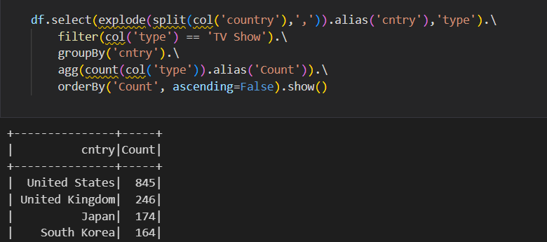
Netflix Data Frames API
Which country has highest comedy movie category? And the total number of comedy movies, by show id.
Which country has the highest tv shows, by show.

Slide 26
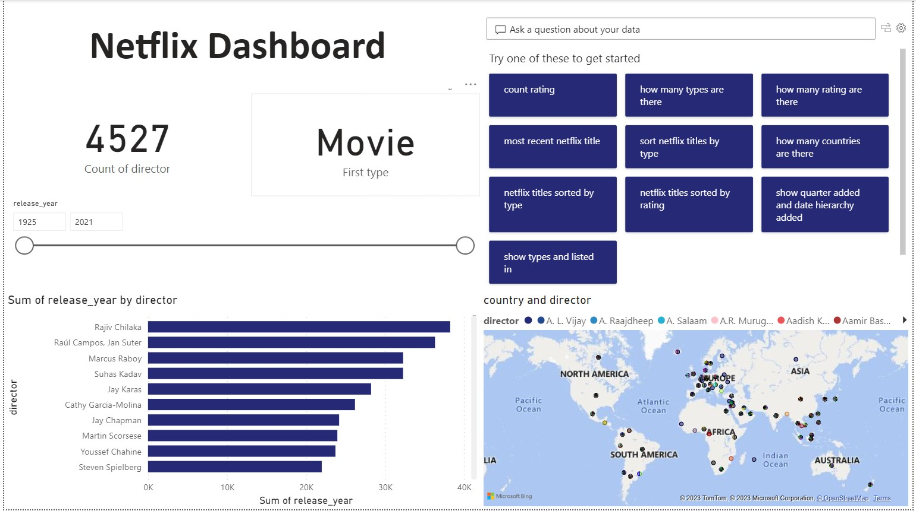
Netflix Dashboard

Slide 27
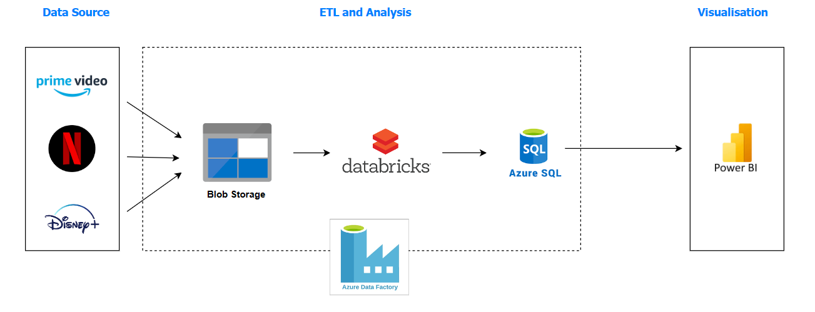
Pipeline

Slide 28
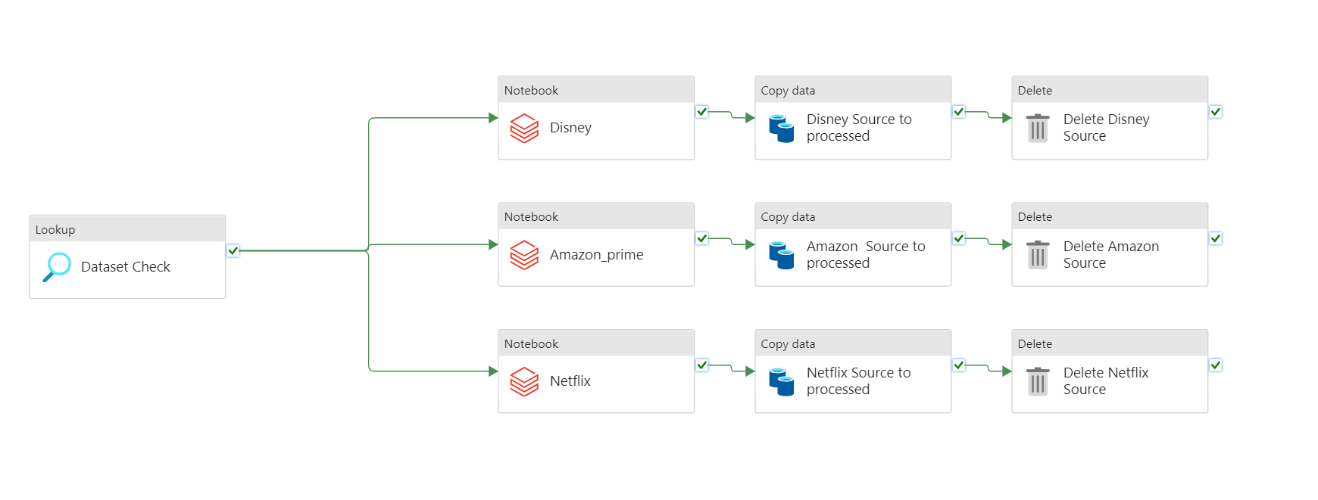
Azure Data Factory

Slide 29

Challenges
Data Pre-Processing
Optimization
Formatting the Nominations & awards of movies in Disney Dataset
Retrieving year from the date column
Exploding the genre column from the Netflix Dataset
Partition & Bucketing in Apache Hive
Cache & Persisting in Apache Spark
Only one Pipeline for all 3 Datasets in Azure Data Factory

Slide 30


Summary

Slide 31





Thank you

